Slide 1
Probability Distributions in R

Slide 2
Probability Distributions
Normal
Binomial
Poisson
Uniform

Slide 3
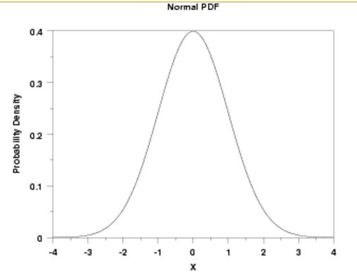


Normal Distribution- probability density function

Slide 4

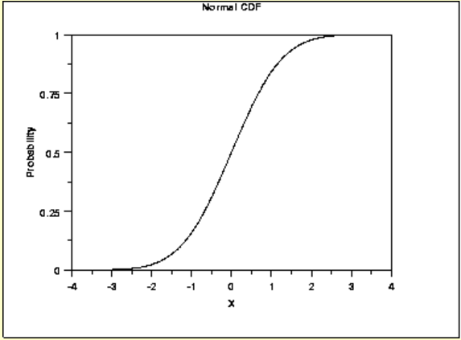
Normal Distribution- Cumulative Distribution Function
The formula for cdf is

Slide 5
Factorial and choose
factorial(4)
choose(6, 3)

Slide 6
R function for Normal Distribution
R has four in built functions to generate normal distribution.
They are described below.
rnorm(n, mean, sd)
dnorm(x, mean, sd)
pnorm(x, mean, sd)
qnorm(p, mean, sd)
Following is the description of the parameters used in above functions −
x is a vector of numbers.
p is a vector of probabilities.
n is number of observations(sample size).
mean is the mean value of the sample data. It's default value is 0.
sd is the standard deviation. It's default value is 1.

Slide 7
The Binomial Distribution
A Binomial Random Variable
  n identical trials
  Two outcomes: Success or Failure
  P(S) = p; P(F) = q = 1 – p
  Trials are independent
  x is the number of Successes in n trials

Slide 8

The Binomial Distribution-Example
A Binomial Random Variable
  n identical trials
  Two outcomes: Success or Failure
  P(S) = p; P(F) = q = 1 – p
  Trials are independent
  x is the number of S’s in n trials
  Flip a coin 3 times
  Outcomes are Heads or Tails
  P(H) = .5; P(F) = 1-.5 = .5

Slide 9
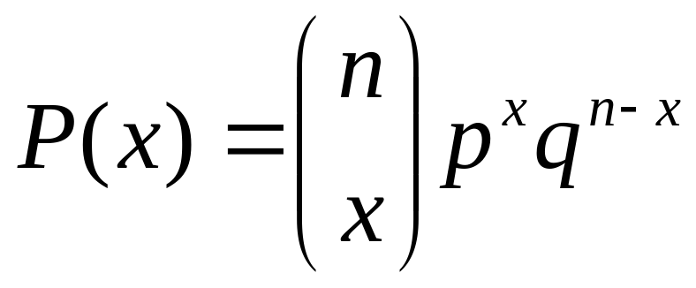
The Binomial Distribution
The Binomial Probability Distribution
  p = P(S) on a single trial
  q = 1 – p
  n = number of trials
  x = number of successes

Slide 10
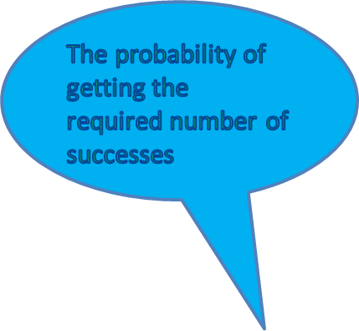
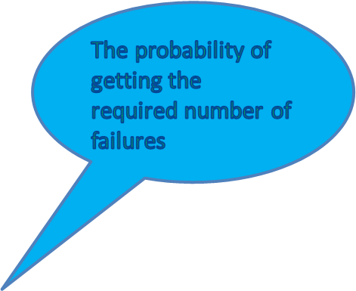

The Binomial Distribution
The Binomial Probability Distribution

Slide 11
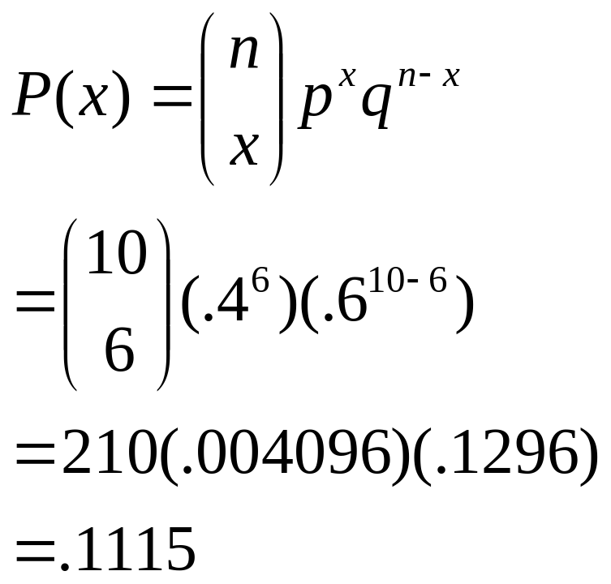
The Binomial Distribution-Example
Say 40% of the class is female.
What is the probability that 6 of the first 10 students walking in will be female?

Slide 12
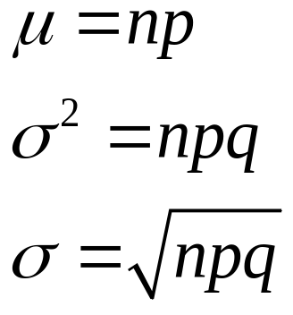
The Binomial Distribution
A Binomial Random Variable has
  Mean
  Variance
  Standard Deviation

Slide 13
Example 1
What is the probability of getting 3 heads out of 6 trials in a coin tossing experiment
p <- 1/2
choose(6,3)*(p^3)*((1-p)^(6-3))
[1] 0.3125
Alternatively, we could use the dbinom function as follows:
dbinom(3, 6, 1/2)
[1] 0.3125

Slide 14
R- Binomial Distribution
R has four in-built functions to generate binomial distribution.
rbinom(r, n, p)
dbinom(v, n, p)
pbinom(v, n, p)
qbinom(u, n, p)
Following is the description of the parameters used −
v is a vector of numbers.
u is a vector of probabilities.
r is number of observations.
n is the number of trials.
p is the probability of success of each trial.

Slide 15
Example 2
Calculate the probability of getting 26 or less heads from a 51 tosses of a coin.

Slide 16
pbinom()
This function gives the cumulative probability of an event. It is a single value representing the probability.
# Probability of getting 26 or less heads from a 51 tosses of a coin.
x <- pbinom(26,51,0.5)
print(x)
0.610116

Slide 17
qbinom()
This function takes the probability value
and gives a number whose cumulative
value matches the probability value.
# If the probability of x successes is 0.25, what is the value of x.
x <- qbinom(0.25,51,1/2)
print(x)

Slide 18
Example 4
Find 8 random values from a sample of 150 with
probability of 0.4

Slide 19
rbinom()
This function generates required number of random
values of given probability from a given sample.
# Find 8 random values from a sample of 150 with
probability of 0.4.
x <- rbinom(8,150,.4)
print(x)

Slide 20
Example 5
Hospital records show that, out of the patients suffering from a certain disease, 75% die of it. What is the probability that 6 randomly selected patients, 4 will recover?

Slide 21
Hospital records show that, out of the patients suffering from a certain disease, 75% die of it. What is the probability that 6 randomly selected patients, 4 will recover?
Example 5
dbinom(4, 6, .25)
0.03295898

Slide 22
Example 6
A professional shooter finds that on the average he hits the target 4 times out of 5. If he fires 4 shots, what is the probability of
(a) more than 2 hits?
(b) at least 3 misses?

Slide 23
Example 6
a) 1-pbinom(2,4,4/5)
b) 3 misses means 1 hit,
and 4 misses means 0 hits.
pbinom(1,4,4/5)
0.0272

Slide 24
The Poisson Distribution
Evaluates the probability of a (usually small) number of occurrences out of many opportunities in a …
  Period of time
  Area
  Volume
  Weight
  Distance
  Other units of measurement

Slide 25
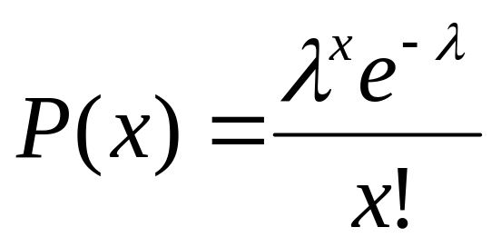
The Poisson Distribution
lambda = mean number of occurrences in the given unit of time, area, volume, etc.
e = 2.71828….

Slide 26
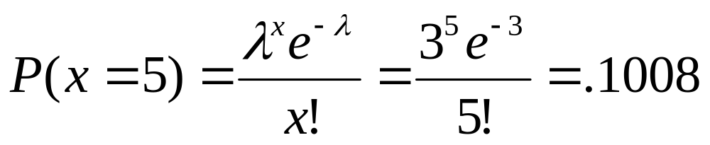

The Poisson Distribution
Say in a given stream there are an average of 3 Blackfin Tuna fishes per 100 yards. What is the probability of seeing 5 Blackfin Tuna fishes in the next 100 yards, assuming a Poisson distribution?

Slide 27
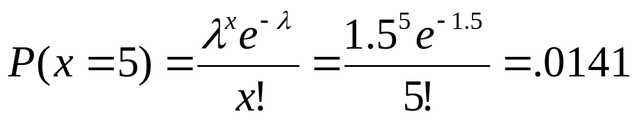
The Poisson Distribution
How about in the next 50 yards, assuming a Poisson distribution?
  Since the distance is only half as long, lambda is only half as large.

Slide 28
Probability Calculation for poison distribution
> dpois(5, lambda=3)

Slide 29
Uniform Distributions:
A uniform distribution is used to describe equiprobable outcomes over a closed interval [a,b]. Because each outcome has the same probability, the R function runif is quite useful for creating a sample of random variables between some minimum and maximum value. For example, we could use the following R code to create a sample of 20 random variables in the interval between 1 and 10:
> runif(20,1,10)
[1] 6.734666 9.334942 4.718385 9.982222 1.912516 1.865814 2.001767 8.011947 1.643035 8.711432
[11] 3.584781 7.679167 3.254184 1.273075 9.030344 6.860417 6.125817 4.510118 3.724532 7.548615

Slide 30
Uniform Distributions:
R also provides probability density, cumulative probability, and quantile functions for the uniform probability distribution (dunif, punif, and qunif respectively).
hist(round(runif(2000,1,10)))

